Slide 1
Muscle Physiology
Lecture 3 Supplement

Slide 2
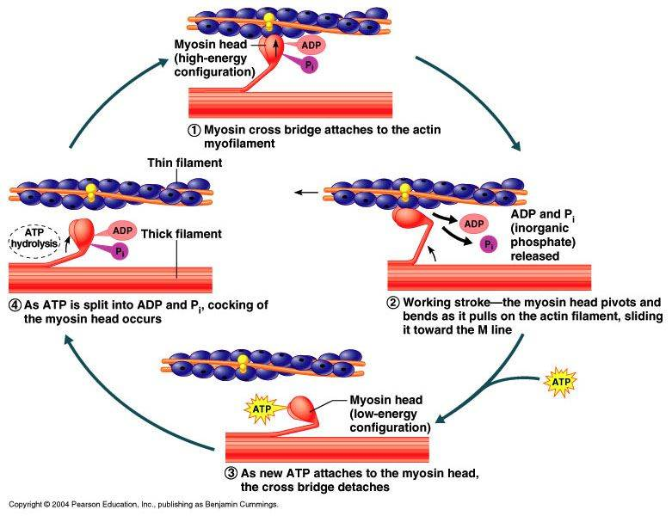
Muscle Physiology
Lecture 3 Supplement
1. Calcium is released
2.
3.
4.
5.
6.
7.
8.
9.
10. And so on. (Muscle contraction continues until the calcium is taken away.)

